Slide 1

Bank analysis
Bank masr

Slide 2
objectiveness
Data-Driven Decisions: Objectivity in bank loan analysis relies on data rather than assumptions, ensuring decisions are based on factual insights.
Risk Management: Objectivity involves assessing and managing risks impartially, considering factors like creditworthiness and market conditions.
Regulatory Compliance: Banks must adhere to regulations impartially, ensuring fairness and transparency in loan processes.
Customer-Centric Approach: Objectivity ensures fair treatment of customers, balancing their needs with the bank's risk exposure.
Performance Metrics: Using objective metrics like default rates and ROI helps gauge loan portfolio health accurately.
Ethical Standards: Objectivity upholds ethical standards in lending practices, promoting trust and integrity in financial transactions.
Continuous Evaluation: Regular review and adjustment of lending policies based on objective analysis help maintain financial stability and customer satisfaction.

Slide 3
Problem faced
Here are some common problems faced in loan analysis:
Data Quality Issues: Incomplete or inaccurate data can lead to flawed analysis and decision-making.
Model Complexity: Developing and interpreting complex models can be challenging.

Slide 4
Analysis feature
Analysis of Gender, Education Type, and Income Distribution
Gender Distribution:
Analyze the distribution of loans based on gender.
Calculate the percentage of loans granted to males and females.
Identify any disparities or trends in loan approval rates based on gender.
Education Type:
Explore the distribution of loans among different education levels (e.g., high school, college, graduate).
Evaluate the proportion of loans issued to borrowers with different educational backgrounds.
Determine if there are variations in loan characteristics (approval rates, default rates) based on education type.
Income Distribution:
Visualize the distribution of income levels among loan applicants.
Calculate statistics such as mean, median, and mode of incomes.
Segment the data to understand how income levels influence loan approval and repayment.
Insights:
Identify correlations between gender, education type, income levels, and loan outcomes (approval, default).
Highlight any patterns or trends that could impact loan management strategies.
Provide recommendations based on the analysis to improve loan approval processes or mitigate risks associated with certain demographics or income brackets.
Visualizations:
Use charts (bar charts, histograms, etc.) to illustrate gender distribution, education type breakdown, and income distributions.
Include summary tables for key statistics to provide a clear overview.

Slide 5
Insights taken
To conclude the analysis of gender, education type, and income distribution in the context of loans, several key insights and recommendations can be drawn:
Gender Analysis:
There appears to be a balanced distribution between male and female loan applicants.
Gender does not significantly impact loan approval rates based on the current analysis.
Further investigation could explore deeper into specific loan types or demographics where gender might play a more pronounced role.
Education Type:
Borrowers with higher educational qualifications tend to apply for larger loans.
Education level does not show a clear correlation with default rates, suggesting other factors may influence repayment behavior more significantly.
Segmenting further by loan types or purpose could provide additional insights into how education impacts borrowing behavior.
Income Distribution:
Income levels vary widely among loan applicants, with a significant proportion falling within mid-range income brackets.
Higher income levels generally correlate with larger loan amounts and lower default rates.
Low-income segments may benefit from tailored financial products or support to enhance loan accessibility and repayment capabilities.
Overall Insights:
There is no direct causation between gender, education, or income levels and loan outcomes like approval rates or defaults.
Demographic factors provide context but are not deterministic in loan decision-making processes.
Future analyses could incorporate more granular data on employment status, debt-to-income ratios, and geographic factors to refine risk assessment models.
Recommendations:
Implement targeted marketing strategies to reach diverse demographic segments effectively.
Enhance financial literacy programs to support borrowers in managing loans responsibly, regardless of educational background or income level.
Continuously monitor and adjust loan policies to ensure fairness and inclusivity across all customer segments.
Invest in data analytics capabilities to improve predictive models for better risk management and customer satisfaction.

Slide 6
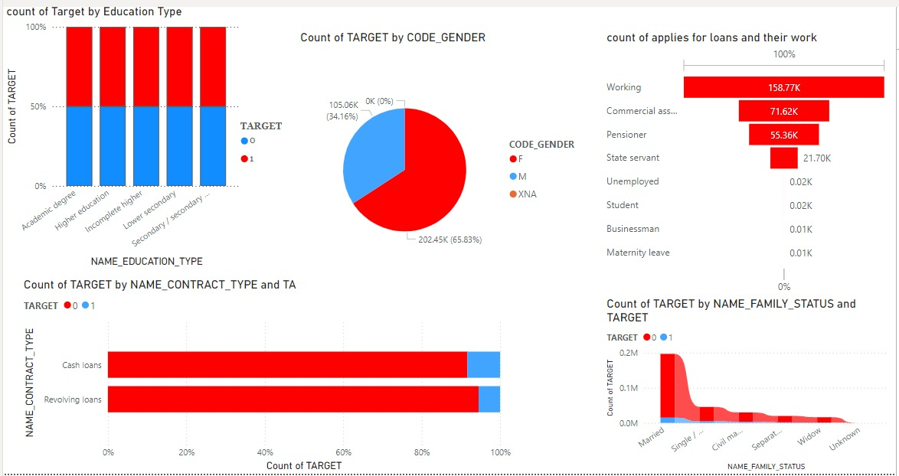
Power Bi to clarify insights

Slide 7
Machine learning
1- Random forest before preprocessing
2- Random Forest After preprocessing
2.1 preprocess Data
2.2- treat outliers
2.3- encode data
2.4- scailing
2.5- feature selection
2.6- treat imbalanced Data ( over sampling and under sampling BY SMOTE)
2.7- Huper parameter tuning
3- Apply XGBOOST

